Slide 1
Group Members:​
Idrees Arshad​ (21L-5632)
Fajar Ejaz​ (21L-5282)
Muhammad Noor Malik (20L-1349)​
Sophia​ Razzaq (21L-5607)
Mamba: Linear-Time Sequence Modeling with Selective State Spaces​

Slide 2

Outlines
Introduction to State Space Models (SSM)
Motivations
Structured State Space Sequence Models (S4)
Comparison to Transformers
Mamba: Selective SSM
Selection Mechanism
Efficient Implementation
Experimental Results
Discussions
Current Extensions
Future Directions

Slide 3
Abstract
Context: Long text, audio, genomics need both content-aware reasoning and linear-time scaling
Key Ideas:
Selective State Spaces: per-token dynamic At,Bt,Ct
Hardware-Aware Scan: fused GPU kernel + parallel prefix-sum → true O(N) recurrence
Contributions:
Input-dependent state updates
Short convolution + GLU gating
SRAM vs HBM placement + kernel fusion + parallel scan
Results:
Transformer-level accuracy, 3–5× faster on A100
Scales to 100K–1M token contexts

Slide 4
Background & Prior Issues
1. What is Sequence Modeling?
Machines process ordered data (text, audio, DNA) for translation, summarization, speech, etc.
2. RNN / LSTM
Sequential recurrence: one token at a time
Drawback: vanishing/exploding gradients → forgetting long-range dependencies
3. Transformer
Self-attention weights every pair of tokens
Drawback: O(N²) time & memory → impractical for very long sequences
4. Question: Can we get linear-time speed AND attention-style focus?
- Answer: Mamba fills that gap.

Slide 5
Gap & Motivation for Mamba
RNN/LSTM: O(N) but forgetful + sequential
Transformer: attention-rich but O(N²) → limited window
Goal: Combine linear-time scaling with attention-style reasoning
Mamba: Selective SSM + hardware-aware scan bridges this gap

Slide 6
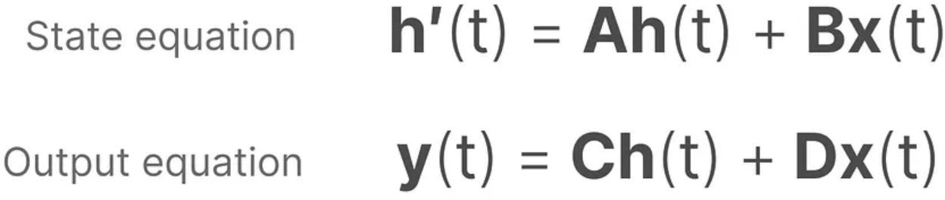
Generic State-Space Models (SSM)
What is an SSM?
A model that maintains a hidden state h(t) and updates it over time based on input u(t).
Continuous-time form:
Intuition:
A governs how the state “flows” on its own.
B injects new information from the input.
C (and D) read out the hidden state as an output.

Slide 7
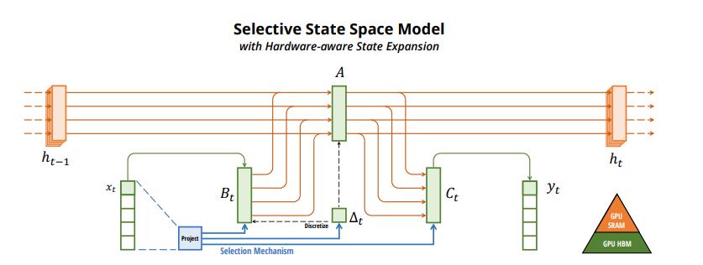

Slide 8
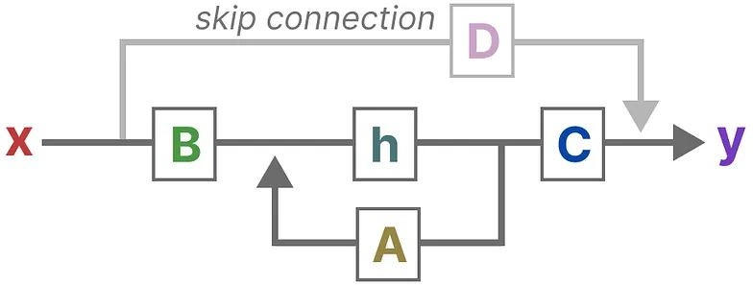
Introduction to State Space Models (SSM)​
Originated from state space methods in control theory
Input: 1-dimensional function or sequence x(t)
Maintain latent state h(t) following
where A, B, C & D are projection matrices. Such an SSM is represented by (A, B, C). D is often omitted as it is only a skip connection.​
​
However, it is too general​
Inefficient to compute,
O(N) per step but full Ā ∈ ℝⁿ×ⁿ is O(N²) to store​
Struggle to remember long dependencies, similar to the vanishing/exploding gradient problem of RNN​

Slide 9
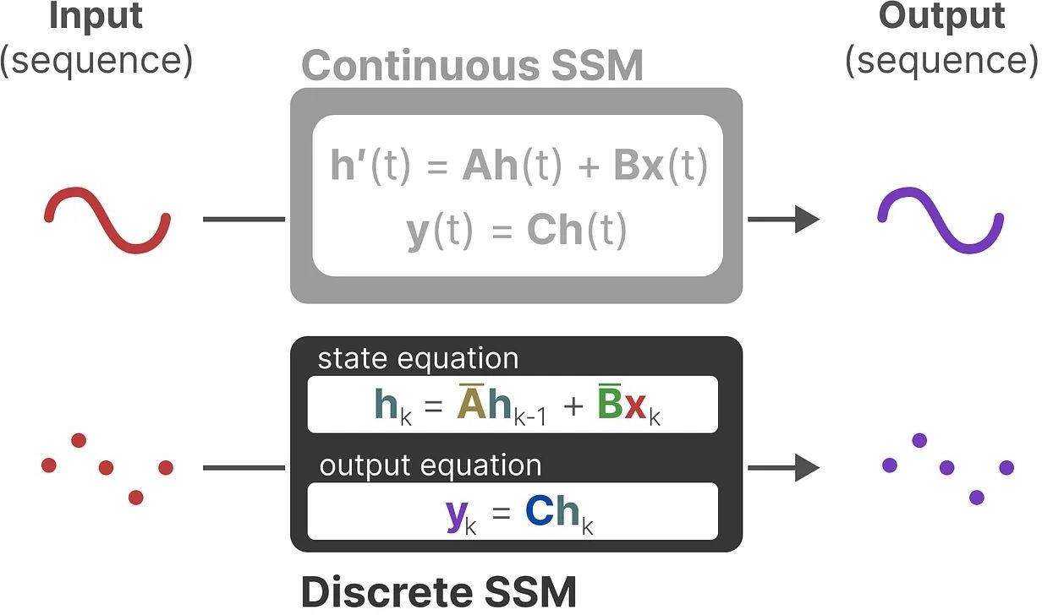
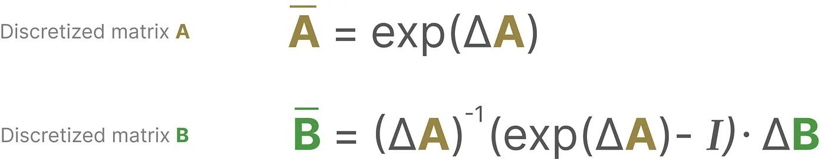
Structured State Space Models (S4)
Discretization: for discrete inputs
e.g. zero-order hold (ZOH)
where ∆ is the step size of sampling.
Now, the discrete SSM can be represented as (∆, A, B, C), or (A, B, C)

Slide 10
Adding “Structure” for Efficiency
• Motivation:
– Generic SSM stores N² parameters in Ā → costly for large N
– We want O(N) storage & compute
• Complexity & Alternative View:
– Params & compute per step: O(N)
– Training via convolution: build kernel K of length L, do x * K in O(N log N) with FFT
• Benefits & Limits:
+ Linear storage & runtime → scales to long sequences
– Kernels are static (same for every token) → no token-specific adaptivity

Slide 11
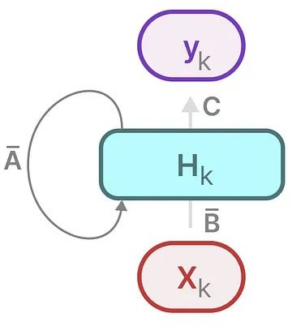
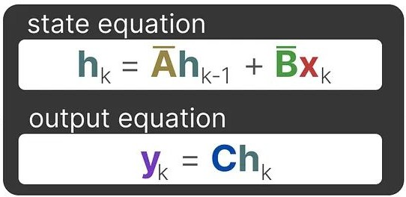

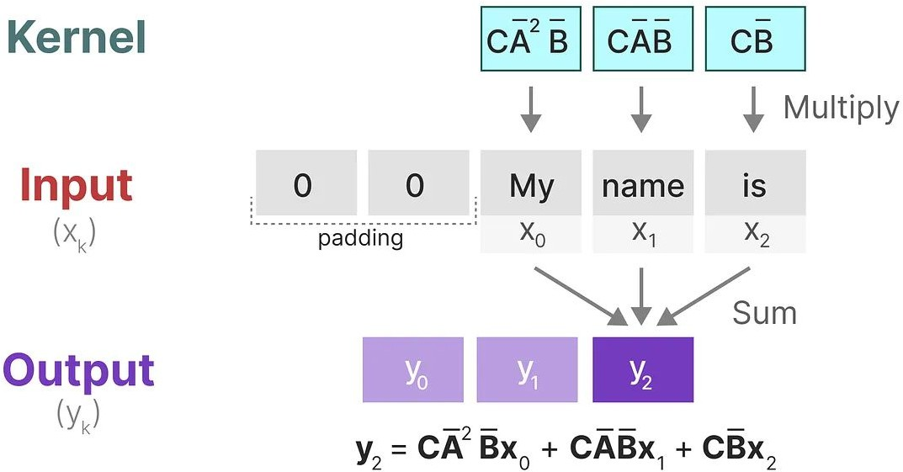
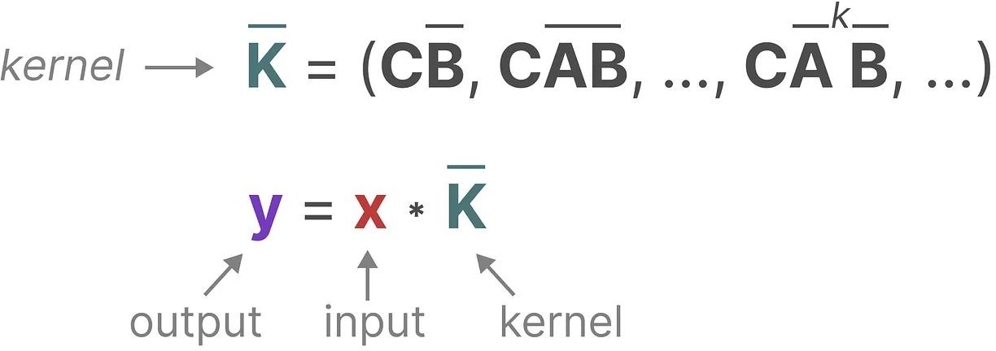

Structured State Space Models (S4)
Computation: Linear Time Invariant (LTI)
Linear recurrence
Global convolution

Slide 12
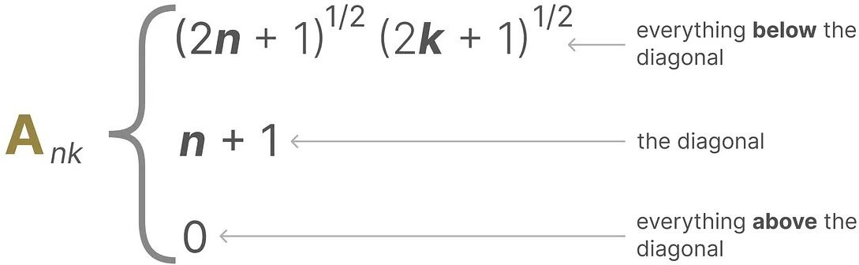
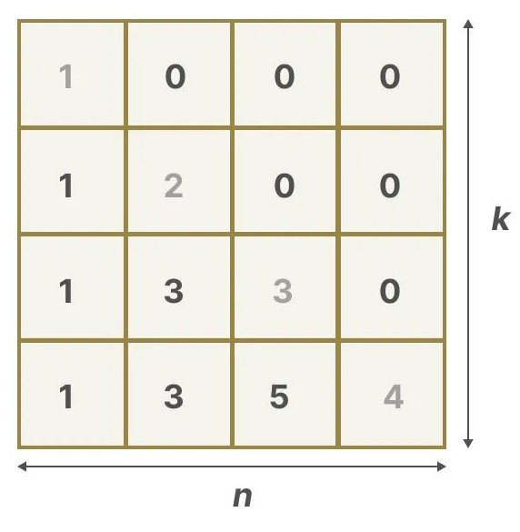
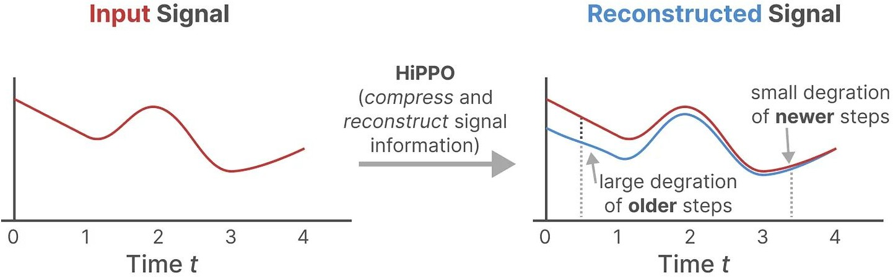
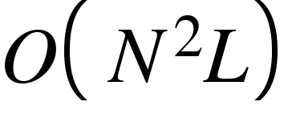

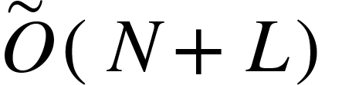

Structured State Space Models (S4)
By imposing structure on matrix A, the system can be solved using efficient algorithms
Popular choices: Diagonal, or High-order Polynomial Projection Operators (HiPPO)
HiPPO can reconstruct older signals, while keeping track of newer signals
○
operations &
space ->
operations and
space

Slide 13
Other Related Works
Linear attention
H3
Hyena
RetNet
RWKV
…

Slide 14

Mamba’s Selective Structured SSM
Selection mechanism:
1. Project xₖ → gₖ ∈ [0,1]ⁿ
2. Modulate base matrices:
Aₖ = gₖ ⊙ A_base
Bₖ = gₖ ⊙ B_base
Cₖ = gₖ ⊙ C_base
3. Recurrence:
hₖ = Aₖ hₖ₋₁ + Bₖ xₖ
yₖ = Cₖ hₖ
Effect: token-dependent gating → content-based filtering

Slide 15
Selective State Space Models - Motivation
Challenge: Sequence models must summarize long contexts into compact states.
Attention models (Transformers) are effective but inefficient — they store all context at each step.
Recurrent models are efficient (constant memory) but lose information over long sequences.
Key Idea: Introduce a selection mechanism — dynamically choose what information to keep or discard based on input.

Slide 16
Synthetic Tasks That Motivate Selection
Selective Copying Task:
Randomize the position of important tokens.
Requires content-based memory — not just time-based recurrence.
Induction Heads Task:
Model must retrieve information based on matching context (like in LLMs).
Exposes the need for input-sensitive memory updates.

Slide 17
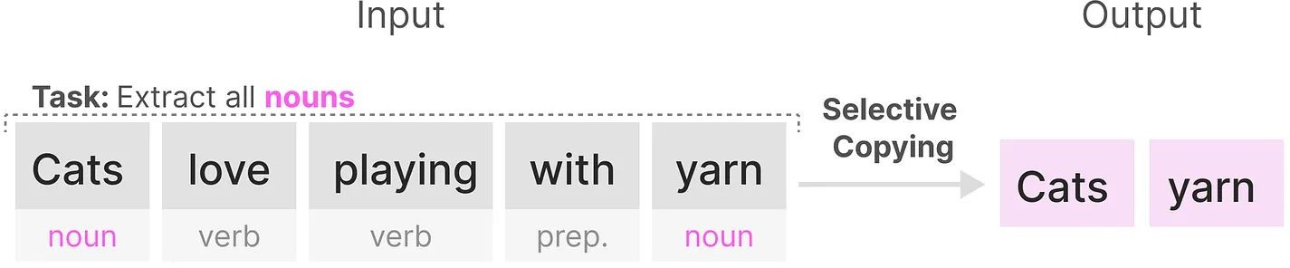
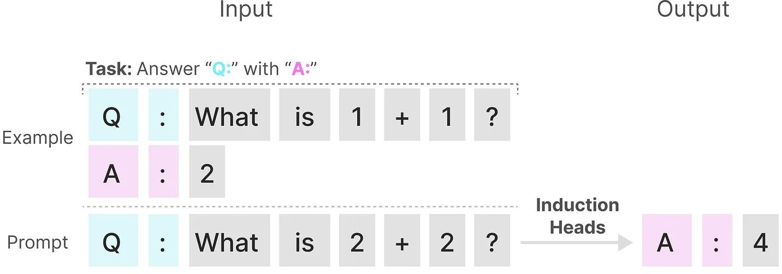
Mamba: Selective SSM
Motivation: Selection as a Means of Compression
Selective Copying task
Induction Heads task
LTI fails as the constant (A, B, C) cannot let them select the correct information.

Slide 18
Limitations of LTI (Linear Time-Invariant) Models
LTI models have fixed dynamics over time — they cannot adapt based on input content.
Global convolution methods can solve fixed-spacing tasks but fail when input significance varies.
Problem: Without input-driven dynamics, models can't properly compress or filter information.
Solution: Move beyond LTI — make dynamics depend on the input itself.

Slide 19
Adding Selectivity to State Space Models
Standard SSMs: Parameters (Δ, A, B, C) are static.
1
Selective SSMs: Parameters (Δ(x), B(x), C(x)) are functions of the current input.
2
The model becomes time-varying, adapting to the sequence content.
3
Tradeoff: Lose convolutional efficiency → need new computation strategies.
4

Slide 20
Selective SSM: Algorithms Compared
Algorithm 1: SSM without selection (S4 model)
Parameters fixed across time → simple to compute.
Algorithm 2: SSM with selection (S6 model)
Parameters vary with input → requires dynamic computation at each timestep.
Key difference:
S4 = time-invariant → convolution/recurrent computation.
S6 = time-varying → must use parallel scan for efficiency.

Slide 21
Computational Challenge with Selective SSMs
Allowing input-based dynamics breaks the convolution shortcut.
Recurrent computation becomes necessary, but naive recurrence is slow.
Large hidden states (size B×L×D×N) cause memory bottlenecks.
Goal: Find an efficient recurrent implementation that scales.

Slide 22

Selective Scan: Hardware-Aware Acceleration
Selective Scan is the hardware-optimized solution:
Kernel fusion reduces memory overhead during operations.
Parallel scan speeds up sequential computation.
Recomputation avoids saving huge intermediate states (reduces GPU memory usage).
State expansions happen only in fast GPU memory (SRAM), minimizing slow memory (HBM) usage.

Slide 23
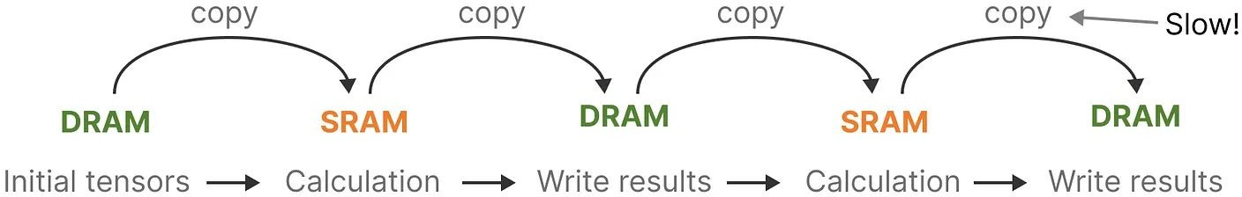
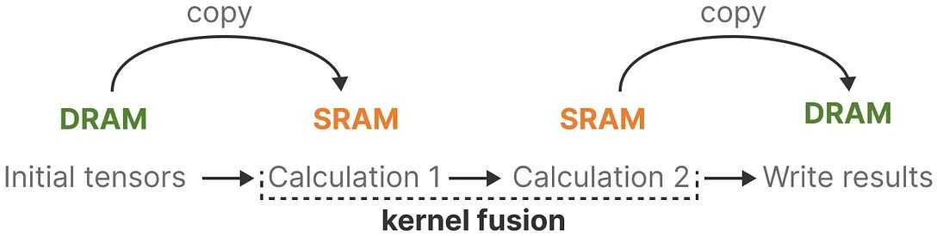
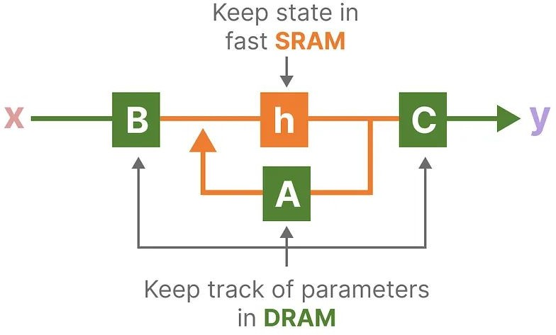
Mamba: Selective SSM
Hardware Awareness

Slide 24
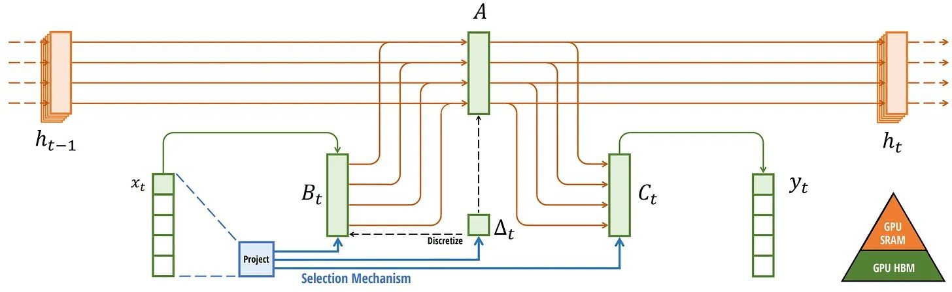
Mamba: Selective SSM
Whole pipeline (S6)

Slide 25
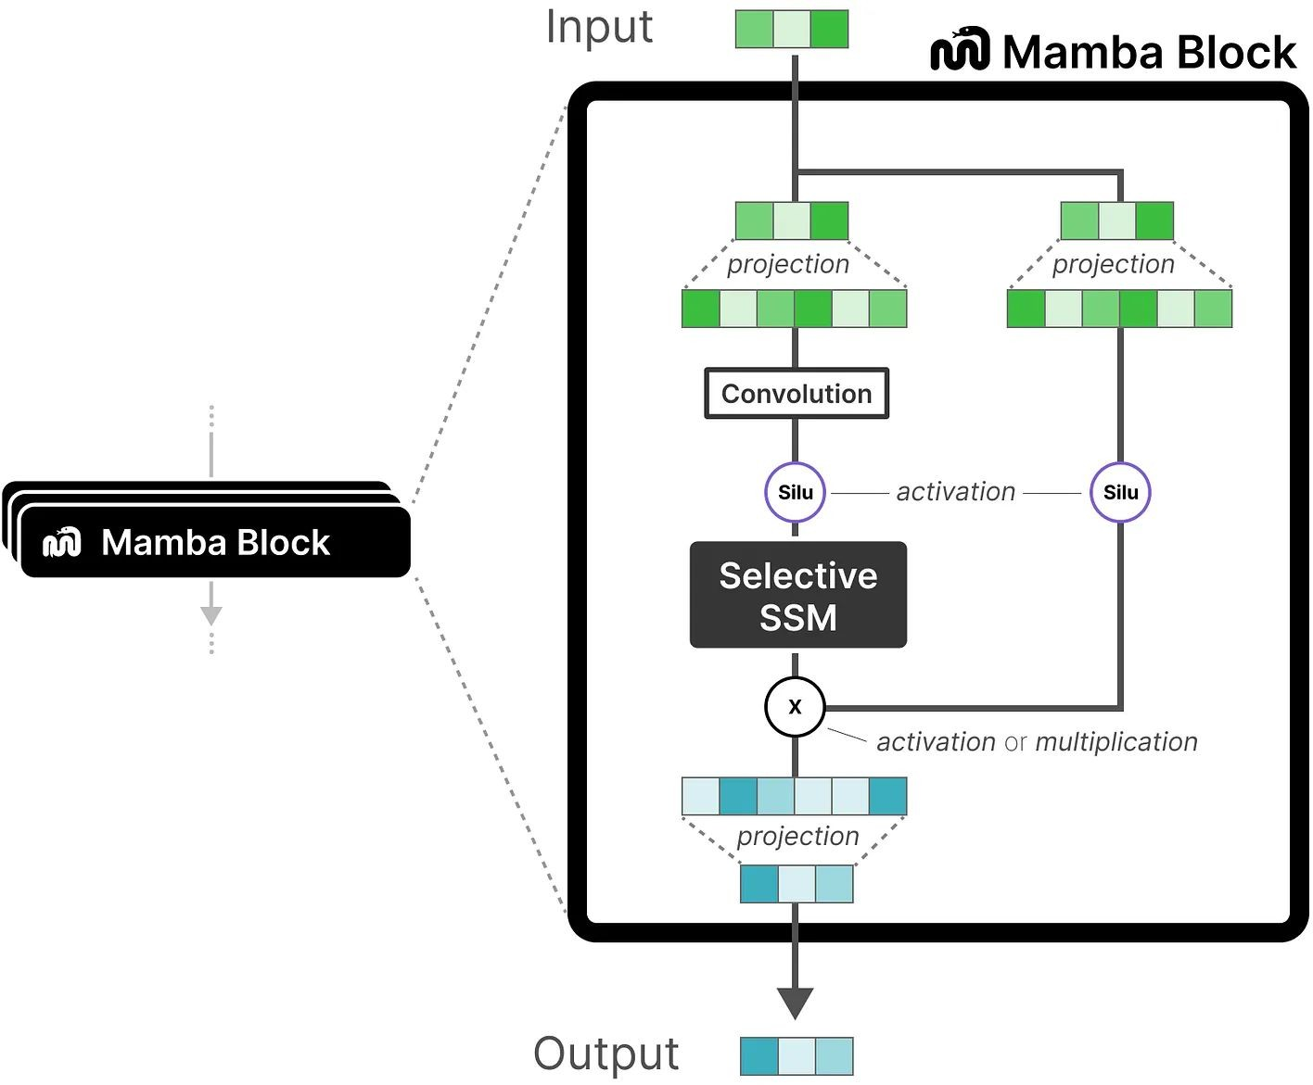
Mamba: Selective SSM
Mamba Block Design

Slide 26

Empirical Evaluations

Slide 27
Overview of Evaluations
Benchmarks across synthetic, language, DNA, and audio domains
Tasks include both pretraining and downstream evaluation
Performance and efficiency measured

Slide 28
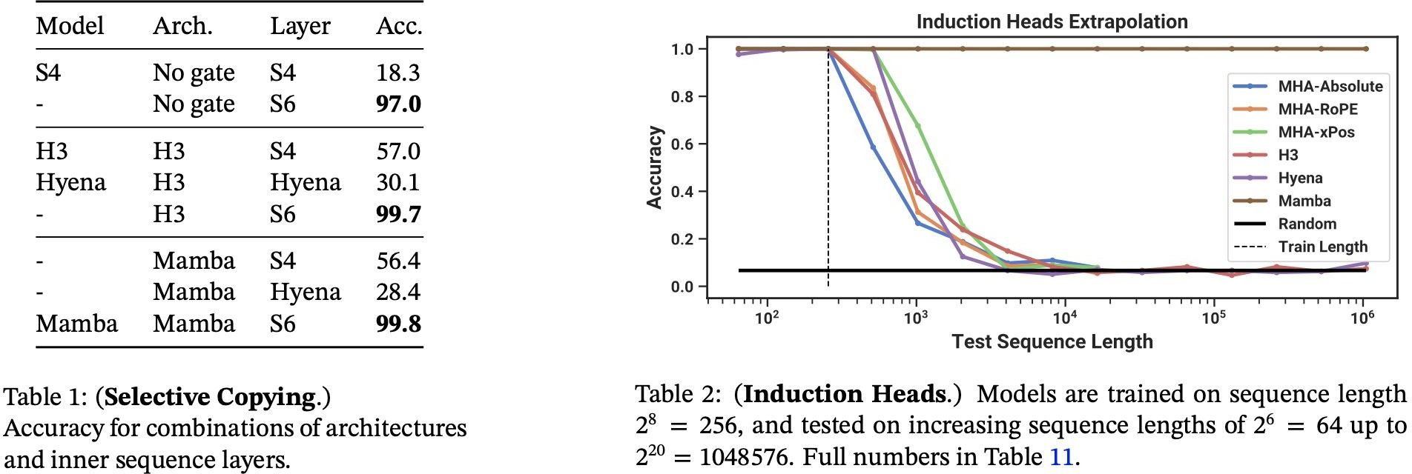
Synthetic Tasks
Selective Copying and Induction Heads
Mamba solves both perfectly
Generalizes up to 1M tokens

Slide 29
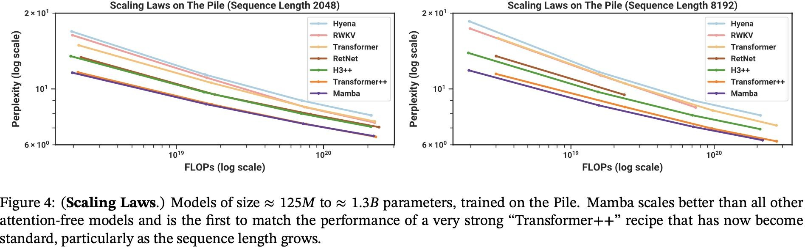
Language Modeling
Benchmarked on The Pile dataset
Compared against Transformers, Hyena, RetNet, RWKV
Mamba matches or exceeds Transformer++ quality

Slide 30
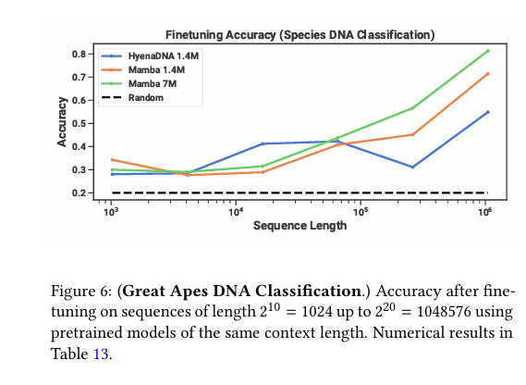
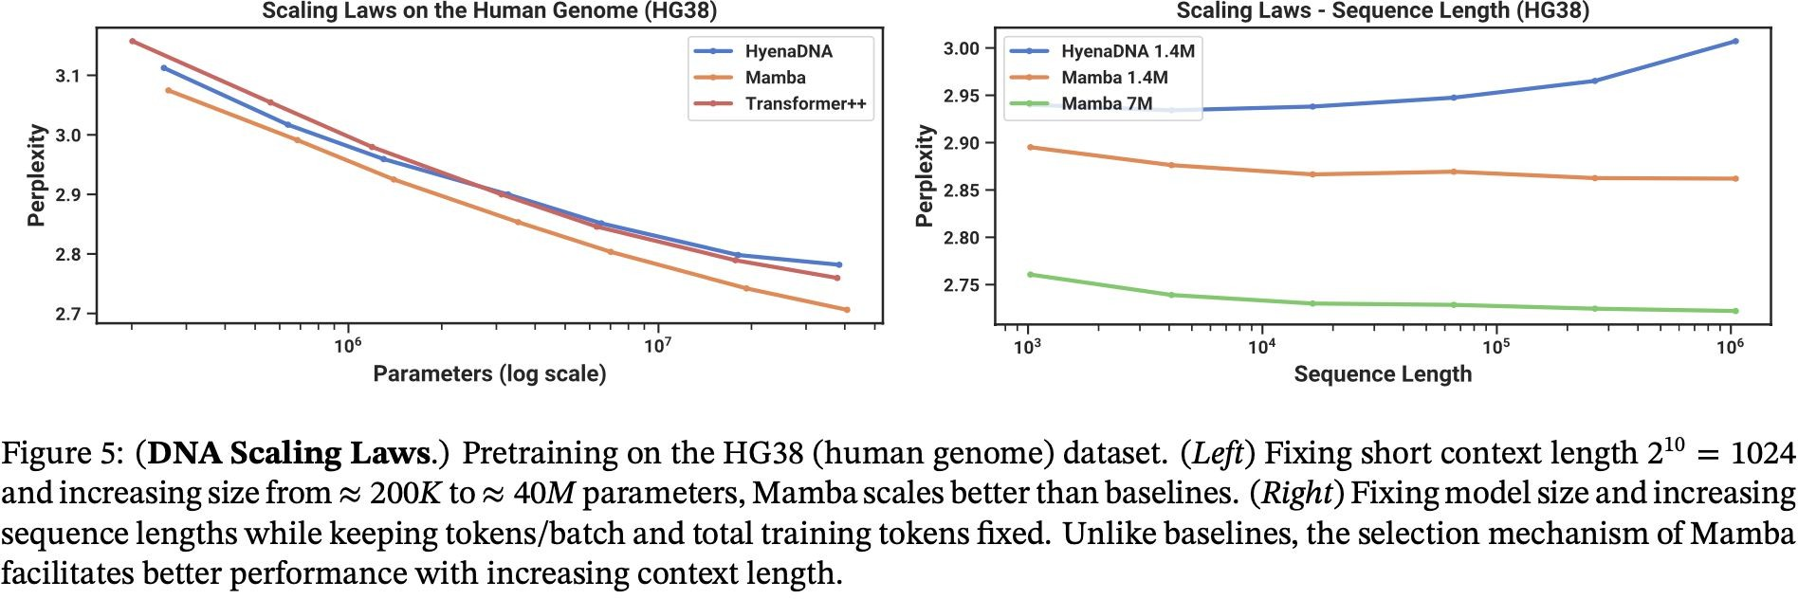
DNA Modeling
Pretraining and fine-tuning on human genome data
Outperforms HyenaDNA and Transformer++
Accuracy improves with longer context

Slide 31
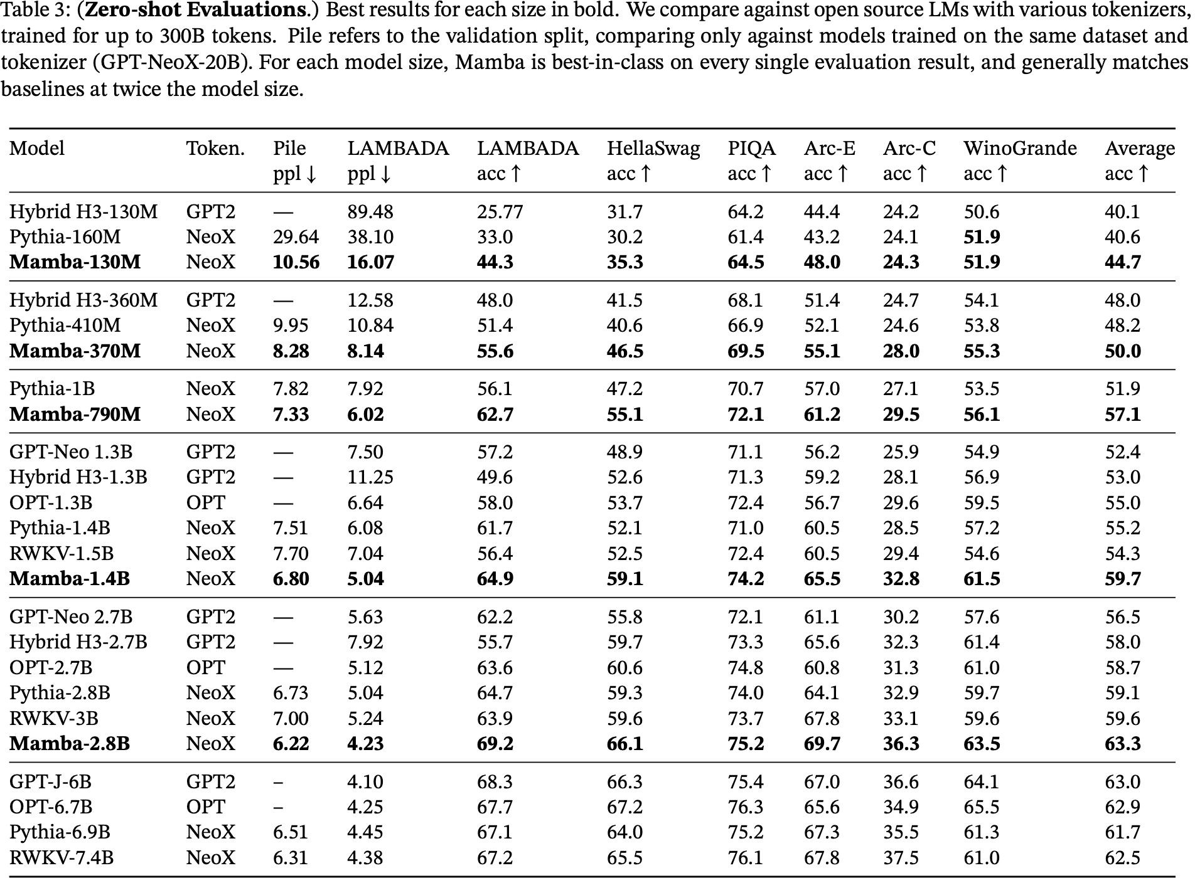
Zero-Shot Results

Slide 32
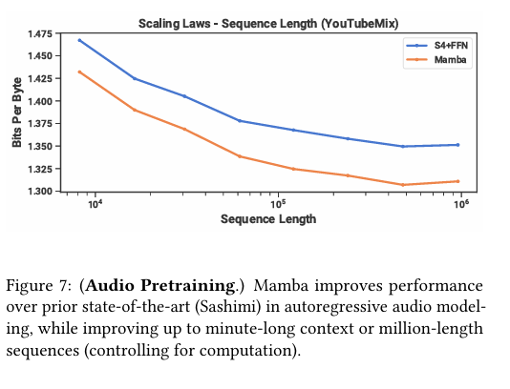
Audio Modeling
Autoregressive training on music and speech
Evaluated on YouTubeMix and SC09 datasets
Best fidelity and inference efficiency

Slide 33
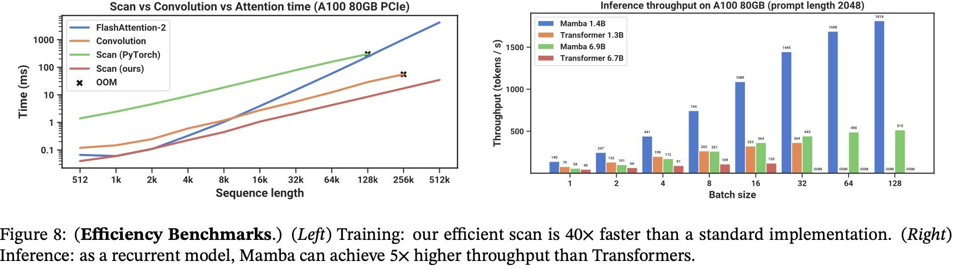
Efficiency

Slide 34
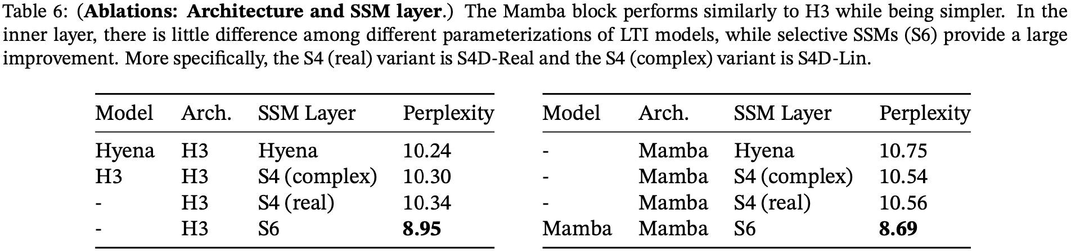
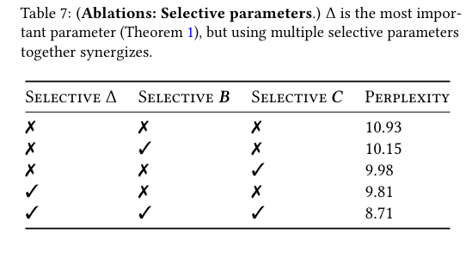
Ablation Studies
Evaluated effects of removing selective components
Delta parameter (Δ) most critical
Selective SSM (S6) outperforms standard SSMs

Slide 35
Discussion
Continuous-Discrete Spectrum:
SSMs were designed for continuous data but the selection mechanism overcomes this in discrete modalities.
Downstream Affordances:
Can SSMs follow the same properties as transformer based models?
Scaling:
Uncertainty as to whether the proposed model will perform on large scales

Slide 36
Discussion: Selection Mechanism
Gating:
Traditional gating algorithm
Multiplicative gating
Hypernetworks:
neural networks whose parameters are themselves generated by smaller neural networks.
Data dependence:
Any notion where some parameters of the model depend on the data
Selection:
Viewed as most closely related to the gating structure of RNNs
Connected to SSMs through Δ

Slide 37
Related Work: Structured SSMs relevant to Mamba
S4:
Introduced the first structured SSM.
Liquid S4:
Augmented S4 with an input-dependent state transition
S5:
The first S4 model to be computed recurrently with the parallel scan.

Slide 38
Strengths and Weaknesses
Strengths
Context-Dependent Reasoning
Maintains linear time complexity
Mamba outperforms all similarly sized models, and matches or exceeds much larger models (e.g., Mamba-2.8B > Pythia-6.9B).
Weaknesses
Limited Evaluation Scope
Limited Ecosystem Support
Selection mechanism helps on discrete tasks (language, DNA) but may degrade performance on continuous signals (e.g., audio)

Slide 39
Future directions
Scaling to Larger Model Sizes
Extending to More Modalities
General Sequence Model Backbone

Slide 40
Thank you!​
Any Questions?​

